Slide 1
Memory Consistency Models
Kevin Boos

Slide 2
Two Papers
Shared Memory Consistency Models: A Tutorial – Sarita V. Adve & Kourosh Gharachorloo – September 1995 All figures taken from the above paper.
Memory Models: A Case for Rethinking Parallel Languages and Hardware – Sarita V. Adve & Hans-J. Boehm – August 2010

Slide 3
Roadmap
Memory Consistency Primer
Sequential Consistency
Implementation w/o caches
Implementation with caches
Compiler issues
Relaxed Consistency

Slide 4
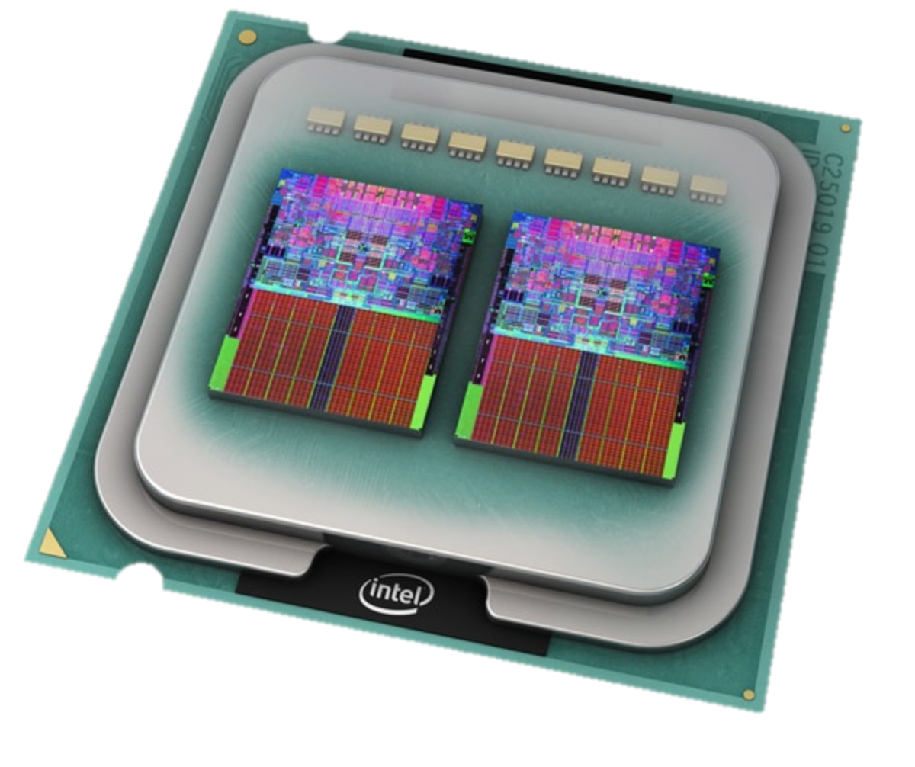
What is Memory Consistency?

Slide 5
Memory Consistency
Formal specification of memory semantics
Guarantees as to how shared memory will behave in the presence of multiple processors/nodes
Ordering of reads and writes
How does it appear to the programmer … ?
Notes:
Intuitively, a read should return the value from the last write, but how do you determine what the “last” write is at any given point?

Slide 6
Why Bother?
Memory consistency models affect everything
Programmability
Performance
Portability
Model must be defined at all levels
Programmers and system designers care
Notes:
Programmability – programmers must understand the memory consistency model in order to correctly reason about the program.
Performance – the memory consistency model determines what type and how many optimizations can be exploited by hardware and software (like the compiler).
Portability – not a huge concern, but if you move programs across systems that have different memory models, you need to be aware of each model and the differences in them.
Defined at all levels:
-- high-level programming languages
-- compilers
-- hardware, including processor, memory subsystem, interconnect, etc.

Slide 7
Uniprocessor Systems
Memory operations occur:
One at a time
In program order
Read returns value of last write
Only matters if location is the same or dependent
Many possible optimizations
Intuitive!
Notes:
Obviously a read returns the value of the last write.
Since there is only a single processor accessing and modifying the data, you don’t have to worry about anyone else tampering with your work.
Optimizations: pipelining, multiple issue, write buffers, overlapping/reordering of instructions that access memory

Slide 8

Sequential Consistency

Slide 9
Sequential Consistency
The result of any execution is the same as if all operations were executed on a single processor
Operations on each processor occur in the sequence specified by the executing program
…
P1
P2
P3
Pn
Memory
Notes:
Must maintain program order among operations from each individual processor
Must maintain a single global sequential order among operations from all processors (memory operations appear to be atomic w.r.t. other operations)

Slide 10
Why do we need S.C.?
Initially, Flag1 = Flag2 = 0
P1 P2
Flag1 = 1 Flag2 = 1 if (Flag2 == 0) if (Flag1 == 0) enter CS enter CS
Notes:
Here’s an example of why sequential consistency is needed.
The designers of certain algorithms EXPECT sequential consistency for those algorithms to work.
This is Dekker’s algorithm for mutual exclusion when entering a critical section…
When P1 wants to enter the CS, it sets its Flag1 to 1, meaning that it is trying to enter the CS. It then checks the value of Flag2 to see if P2 has tried to enter the CS.
If not, then it enters the CS.
This relies on the fact that P1’s read of Flag2 has not been interleaved with P2’s read of Flag1.
If P2 read Flag1 before it received the updated value of Flag1 from P1’s write, then both P1 and P2 might enter the CS.
This examples illustrates why program order must be preserved.

Slide 11
Why do we need S.C.?
Initially, A = B = 0
P1 P2 P3
A = 1 if (A == 1) B = 1 if (B == 1) register1 = A
Notes:
Another example shows why memory operations need to be atomic.
The effect of P1’s write to A must be seen by both P2 AND P3 at the same time.
If not, P2 may read A as 1, and then set B equal to 1.
P3 then reads B as 1 because it has received the update from P2, but it hasn’t yet received P1’s update of A = 1, so it uses the old value of A instead of 1.
So without Sequential Consistency, register1 might get the wrong value of A because the writes to A and B were not ATOMIC.

Slide 12
Implementing Sequential Consistency
(without caches)
Notes:
We’ll discuss 3 types of hardware operations

Slide 13
Write Buffers
P1 P2
Flag1 = 1 Flag2 = 1 if (Flag2 == 0) if (Flag1 == 0) enter CS enter CS
Notes:
Let’s consider a system that has write buffers.
When a processor wants to write, it simply queues that write in a write buffer and then proceeds without waiting for the write to complete.
The next read operation can proceed before the write finishes, as long as there are no writes in that processor’s local write buffer that have the same location as the read.
P1 could issue a write to Flag1, which then might be delayed in the write buffer. Then, P2 can read the old value of Flag1 before P1’s write completes

Slide 14
Overlapping Writes
P1 P2
Data = 2000 while (Head == 0) {;} Head = 1 ... = Data
Notes:
Another hardware optimization for uniprocessors is performing writes out-of-order, so that one write overlaps another.
In this example, P1 may issue a write to Data, and then issue the write to Head, but because the writes can be overlapped,
the write to Head actually completes before the write to Data.
Then P2 reads the new value of Head as 1, and continues on to read Data as the old value of Data, because P1’s write of Data hasn’t yet completed.
So, in this case, even though write operations weren’t reordered when they’re writing to the same location, it still violates sequential consistency
by writing to different locations out of order.
How to fix this? Use write acknowledgements that prevent a processor from issuing another write until its previous write was acknowledged as complete by the memory module.

Slide 15
Non-Blocking Read
P1 P2
Data = 2000 while (Head == 0) {;} Head = 1 ... = Data
Notes:
Let’s imagine a system that allows non-blocking reads. This is similar to a write buffer, in that a read operation immediately returns before it has completed the read and returned the data.
With non-blocking reads, it is possible for this same program to be sequentially inconsistent.
P2 issues a read from Head, and because it’s non-blocking, P2 immediately issues a read from Data before the first read finishes.
P2’s read from Data completes, and then P1 writes Data and Head. Then P2’s read of Head completes and it reads Head as a 1 while Data was read as the old value.

Slide 16
Implementing Sequential Consistency
(with caches)

Slide 17
Cache Coherence
A mechanism to propagate updates from one (local) cache copy to all other (remote) cache copies
Invalidate vs. Update
Coherence vs. Consistency?
Coherence: ordering of ops. at a single location
Consistency: ordering of ops. at multiple locations
Consistency model places bounds on propagation
Notes:
Sometimes it’s called cache consistency in the literature, which is why it can be so damn confusing at time.
Coherence – Writes to the same location appear to be seen by all processors in the same order (serialization of writes to same location).
Consistency – Writes to all locations must be seen in the same order by all processors. And each processor must execute ops in program order.

Slide 18
Write Completion
P1 P2 (has “Data” in cache)
Data = 2000 while (Head == 0) {;} Head = 1 ... = Data
Write-through cache
Notes:
In this case, we’re assuming a system has standard caches for each processor, and each processor’s cache is coherent with all others.
Suppose that P2 initially has Data in its local cache. P1 writes 2000 to Data, and the cache writes it through to main memory and begins propagating that update to P2’s cache.
P2 then continues on to write 1 to Head, which writes through to main memory and starts the update process.
P1 tries to read Head, and because there wasn’t a copy of Head in its cache, it has to read from main memory.
So it reads the new value of Head as 1, and then it reads the old value of Data from its cache before it receives the update from P1’s cache.
We can fix this by requiring P1 to wait until Data is finished propagating before starting the write to Head.
This would happen if we had acknowledgements sent from a cache back to the processor whenever it had completed an update cycle.

Slide 19
Write Atomicity
Propagating changes among caches is non-atomic
P1 P2 P3 P4
A = 1 A = 2 while (B != 1) { } while (B != 1) { }
B = 1 C = 1 while (C != 1) { } while (C != 1) { }
register1 = A register2 = A
register1 == register2?
Notes:
Consider an update based cache coherence protocol.
If the writes to A by P1 and P2 arrive at P3 and P4 in different orders, then sequential consistency may be violated.
This could happen in a system with a general interconnect that doesn’t preserve the ordering of messages, so a write operation would not be atomic system-wide.
Can fix this by waiting to issue a write if another write to the same location is still being updated/invalidated.

Slide 20
Write Atomicity
Initially, all caches contain A and B
P1 P2 P3
A = 1 if (A == 1) B = 1 if (B == 1) register1 = A
Notes:
Here’s another example of where write atomicity is important in a cache coherent system.
P1 writes 1 to A, and then its cache sends updates to P2 and P3.
P2 receives the update to A from P1, and then writes to B, sending an update for B to P1 and P3.
P3 then receives the P2’s update to B before it receives P1’s update to A, meaning that this if conditional is true.
Since it hasn’t yet received P1’s update of A, P3 reads an outdated version of A from its own local cache.
So register1 ends up with the wrong value.
Since the writes of A and B appear to P2 and P3 in different orders, the writes do NOT appear atomic to the system.
This could be fixed by requiring a processor to get acknowledgements from all other caches that a write has fully propagated before issuing any additional memory operations (like read or write).

Slide 21
Compilers
Compilers make many optimizations
P1 P2
Data = 2000 while (Head == 0) { } Head = 1 ... = Data
Notes:
Optimizations:
-- register renaming
-- code motion
-- eliminating sub expressions
Compiler allocates a register on P2, followed by a single read operation of Head from memory into that register.
Then, no matter what P1 writes to Head, P2 will never re-read the new value of Head.
It will just loop infinitely…
This is fine on a uniprocessor system because the compiler can safely assume that no other entities will modify the value of Head.
Essentially, eliminating memory operations with techniques like register allocation can violate sequential consistency.

Slide 22
Sequential Consistency
… wrapping things up …

Slide 23
Overview of S.C.
Program Order
A processor’s previous memory operation must complete before the next one can begin
Write Atomicity (cache systems only)
Writes to the same location must be seen by all other processors in the same location
A read must not return the value of a write until that write has been propagated to all processors
Write acknowledgements are necessary

Slide 24
S.C. Disadvantages
Difficult to implement!
Huge lost potential for optimizations
Hardware (cache) and software (compiler)
Be conservative: err on the safe side
Major performance hit

Slide 25

Relaxed Consistency

Slide 26
Relaxed Consistency
Program Order relaxations (different locations)
W → R; W → W; R → R/W
Write Atomicity relaxations
Read returns another processor’s Write early
Combined relaxations
Read your own Write (okay for S.C.)
Safety Net – available synchronization operations
Note: assume one thread per core
Notes:
Write atomicity relaxations apply only to systems with a cache.
All of these re

Slide 27
Comparison of Models
Notes:
From top to bottom, we see consistency models that are increasingly relaxed. The topmost one is sequential consistency, where every

Slide 28
Write → Read
Can be reordered: same processor, different locations
Hides write latency
Different processors? Same location?
IBM 370
Any write must be fully propagated before reading
SPARC V8 – Total Store Ordering (TSO)
Can read its own write before that write is fully propagated
Cannot read other processors’ writes before full propagation
Processor Consistency (PC)
Any write can be read before being fully propagated
Notes:
A write then a read can be reordered as long as they’re not to the same location. Only works for a single processor.

Slide 29
Example: Write → Read
P1 P2
F1 = 1 F2 = 1 A = 1 A = 2 Rg1 = A Rg3 = A Rg2 = F2 Rg4 = F1
Rg1 = 1 Rg3 = 2 Rg2 = 0 Rg4 = 0
P1 P2 P3
A = 1 if(A==1) B = 1 if (B==1) Rg1 = A
Rg1 = 0, B = 1
TSO and PC
PC only
Notes:
A write then a read can be reordered as long as they’re not to the same location. Only works for a single processor.
LEFT PROGRAM:
This result couldn’t happen with IBM 370, because it requires writes to fully propagate before reads can happen.
So Register 1 and register 3 would have to read the same value.
However, it is possible with TSO and PC because they can both read their own writes before it propagates to the other processor. That’s how they each see a different value of A here.
RIGHT PROGRAM:
This can happen only with processor consistency (PC), which would allow P3 to read A before P1’s updates had fully propagated.
It basically reads A before P2 does, meaning that P2 gets a different new value of A than P3.

Slide 30
Write → Write
Can be reordered: same processor, different locations
Multiple writes can be pipelined/overlapped
May reach other processors out of program order
Partial Store Ordering (PSO)
Similar to TSO
Can read its own write early
Cannot read other processors’ writes early

Slide 31
Example: Write → Write
P1 P2
Data = 2000 while (Head == 0) {;} Head = 1 ... = Data
PSO = non sequentially consistent
… can we fix that?
P1 P2
Data = 2000 while (Head == 0) {;} STBAR // write barrier Head = 1 ... = Data

Slide 32
Relaxing All Program Orders

Slide 33
Read → Read/Write
All program orders have been relaxed
Hides both read and write latency
Compiler can finally take advantage
All models: Processor can read its own write early
Some models: can read others’ writes early
RCpc, PowerPC
Most models ensure write atomicity
Except RCsc
Notes:
This is analogous to TRULY non-blocking reads. It also facilitates speculative execution.

Slide 34
Weak Ordering (WO)
Classifies memory operations into two categories:
Data operation
Synchronization operation
Can only enforce Program Order with sync operations data data sync data data sync
Sync operations are effectively safety nets
Write atomicity is guaranteed (to the programmer)
Notes:
The programmer has to be the one to identify which operations are sync and which are data.
It’s guaranteed that writes always appear atomic to the programmer

Slide 35
Release Consistency
More classifications than Weak Ordering
Sync operations access a shared location (lock)
Acquire – read operation on a shared location
Release – write operation on a shared location
ordinary
shared
nsync
acquire
special
sync
release
Notes:
Ordinary and special are similar to the classifications in Weak Ordering, data and synchronization.
Nsync is NOT the popular boy band from the 90s.
Nsync operations are a special type of asynchronous data operations that aren’t used for synchronization.

Slide 36
R.C. Flavors
RCsc
RCpc
Maintains sequential consistency among “special” operations
Program Order Rules:
acquire → all
all → release
special → special
Maintains processor consistency among “special” operations
Program Order Rules:
acquire → all
all → release
special → special (except sp. W → sp. R)
Notes:
The notation for the program order rules is as such:
A → B means that program order is enforced between operations of those two types.
So, both flavors of release consistency guarantee that program order is maintained between:
-- An acquire operation followed by any operations (entering a CS)
-- any operations before a release operation (exiting a CS)
-- any special operation followed by another special operation
SPECIAL operation is really any operation that could create a data race.
EXCEPT in RC processor consistency, which takes a page from the book of Processor Consistency in that
Program order is not maintained between a special Write and a subsequent special Read operation.
That basically just means that you can read other processors’ writes early.
So basically, RCpc is a special version of RCsc that is even more relaxed.

Slide 37
Other Relaxed Models
Similar relaxations as WO and RC
Different types of safety nets (fences)
Alpha – MB and WMB
SPARC V9 RMO – MEMBAR with 4-bit encoding
PowerPC – SYNC
Like MEMBAR, but does not guarantee R → R (use isync)
These models all guarantee write atomicity
Except PowerPC, the most relaxed model of all
Allows a write to be seen early by another processor’s read
Notes:
Alpha has a memory barrier and a write memory barrier.
Alpha guarantees write atomicity.

Slide 38
Relaxed Consistency
… wrapping things up …

Slide 39
Relaxed Consistency Overview
Sequential Consistency ruins performance
Why assume that the hardware knows better than the programmer?
Less strict rules = more optimizations
Compiler works best with all Program Order requirements relaxed
WO, RC, and more give it full flexibility
Puts more power into the hands of programmers and compiler designers
With great power comes great responsibility

Slide 40
A Programmer’s View
Sequential Consistency is (clearly) the easiest
Relaxed Consistency is (dangerously) powerful
Programmers must properly classify operations
Data/Sync operations when using WO and RCsc,pc
Can’t classify? Use manual memory barriers
Must be conservative – forego optimizations ☹
High-level languages try to abstract the intricacies
P1 P2
Data = 2000 while (Head == 0) {;} Head = 1 ... = Data

Slide 41
Final Thoughts

Slide 42
Concluding Remarks
Memory Consistency models affect everything
Sequential Consistency
Ensures Program Order & Write Atomicity
Intuitive and easy to use
Implementation, no optimizations, bad performance
Relaxed Consistency
Doesn’t ensure Program Order
Added complexity for programmers and compilers
Allows more optimizations, better performance
Wide variety of models offers maximum flexibility

Slide 43
Modern Times
Multiple threads per core
What can threads see, and when?
Cache levels and optimizations

Slide 44
Questions?

